Slide 1
Topic Modelling of Building Incidents with Injuries
Darius Mehri
Risk Management Analyst

Slide 2
Objective
Exploratory analysis to understand main themes related to building incidents with injuries.
Analyze how the themes have changed over time

Slide 3
Data and Method
All incidents with one or more injuries from January 2007 through October 2016.
Total of 4839 incidents with injuries
Text that briefly describes the incident.
Method: Topic modelling, an unsupervised machine learning algorithm, used to uncover main themes in the text.
The method automatically develops “topics” from the text.

Slide 4
Quality Control
Topic modelling is good at finding themes in text, but has issues with accuracy.
Sometimes text not classified properly
Topics can be ambiguous
Accuracy Improvement: Top words created by the algorithm for each topic were used as key words in an algorithm I developed to recode the text
Algorithm developed in python.
Key words were grouped and used conditionally to code the text according to the key words in the topic.
Increased accuracy.
When text was recoded, tested the quality of algorithm by drawing sample and checking accuracy.
When error found, tweaked the algorithm to improve accuracy.
Implemented automatic spell corrector on misspelled words, improved accuracy by about 10%

Slide 5
Results
92% of the incidents were classified into 20 topics
8% of the incidents could not be classified.
The 20 topics fit into 2 main categories
1. Workers injured on the job, i.e. worker falling from structure, cuts to body, heart attack, etc. The titles of all of these topics begin with “worker”.
2. Building related incidents – Partial building collapse, vehicle hitting building, falling debris, etc.

Slide 6
The Topics
The topics in order of their frequency, from high to low.
Worker Fell
Worker falling from a building structure while working, typically from a scaffold, building floor, or elevator shaft.
Key Words: fell, falling, worker(s), scaffold, ladder
Structural Stability Test
A structural stability test is called into the DOB due to a fire, vehicle hitting the building, partial building collapse, general building structural problems.
Key Words: Structure, stability, test, check, vehicle, building

Slide 7
Elevator Incident
Person’s hand trapped in elevator door, stuck in elevator cab, falling down shaft, children getting hands caught in elevator door, etc.
Key Words: elevator, door, closed, passenger, enter, open
Worker Miscellaneous Body
Worker injured hand with hammer, drill, foot injuries such as stepping on nail, pinching fingers in tool, poking eye, etc.
Key Words: leg, knee, eye, hand, arm, finger, bleeding
This is a “miscellaneous” topic because it is not classified as one of the well-defined worker-related injury topics. The well-defined injuries include Worker Struck in Head/Face/Body, Worker Tripped, Worker Cut Body, Worker in Motion, Worker Back and Pulled Muscle, Worker Sick, Worker with Chest Pain and Worker Electrocuted.
Worker Object Struck Head/Face/Body
An object struck the body part of a worker, mostly face and head, but also includes chest and leg. Objects include crane hoist, steel beam, pipe, crowbar, hammer, etc.
Key Words: struck, hit, face, eye, nose, chest

Slide 8
Worker/Person Tripped
Worker tripped or slipped on the job. Also includes non-workers, such as customers shopping at a store tripping on escalator or elevator.
Key Words: tripped, slipped, walk, knee, forehead
Worker Cut Body
Cuts and lacerations to all body parts, but mostly to fingers and hand while cutting construction material.
Key Words: cut, severed, lacerate, finger, thumb, hand
Worker in Motion
Worker injured primarily when loading and unloading construction material. Also includes installing, handling and climbing.
Key Words: loading, unloading, lifting, installing, handling

Slide 9
Escalator Incident
Injury resulting from riding an escalator, mostly foot or hand getting caught in the escalator, many involve children.
Key Words: escalator, step, fell, lost, balance, children (boy, girl)
Falling Debris
Worker injured by falling debris, bricks, scaffold, sheetrock, metal, etc
Key Words: fell, debris, brick, scaffold, fence, masonry
Worker Back and Pulled Muscle
Worker injures back or pulls muscle.
Key Words: pull, back, muscle, injured, strain, twist, spasm
Worker Sick
Worker feels sick on the job, may or may not be work related. Many are serious, such as seizures or strokes, while others seem less serious, such as worker feels dizzy or light headed.
Key Words: sick, ill, went, sent, dizzy, blood

Slide 10
Pedestrian Incident
Mostly construction material or pieces of facade hitting pedestrians while they are walking on the street, also includes vehicles hitting both buildings and pedestrians, and consumer objects from building falling on pedestrians (i.e. air conditioner)
Key Words: pedestrian, brick, serious, facade, equipment, assist
Partial Building Collapse
Part of the building collapses, typical incidents include wall, ceiling, scaffold, floor. This topic does not include total building collapse.
Key Words: collapse, partial, scaffold, wall, floor, ceiling, fence, etc.
Vehicle Struck Sidewalk Shed
A vehicle struck a sidewalk shed causing damage to the building and/or construction site. Also includes vehicle hitting scaffold.
Key Words: car, truck, vehicle, shed, scaffold
Concrete Incident
Injuries caused by working with concrete.
Key Words: concrete, pouring, pumping, cutting

Slide 11
Fire
Fire related injuries
Key Words: fire, alarm
Worker Chest Pain
Worker feels chest pain or has heart attack.
Key Words: chest, pain, heart, cardiac
Worker Electrocuted or Burned
Worker is electrically shocked, or experiences a burn while working
Key Words: electrocuted, burned, shocked
Crane Incident
Any crane related incident, includes collapse, car hitting crane, worker being hit by crane, etc.
Key Words: crane, hit, collapse

Slide 12
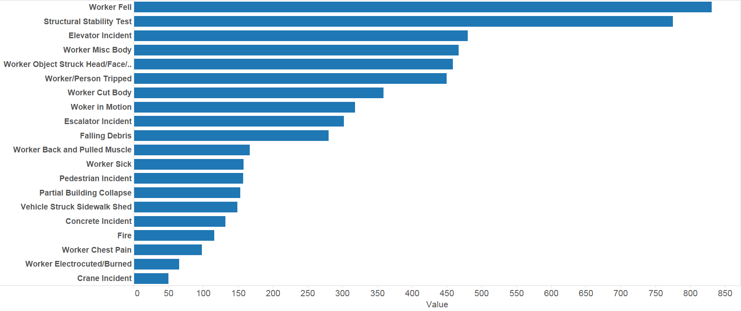
Topic by Count, 2007 - 2016

Slide 13

Topic Percent, 2007 - 2016

Slide 14
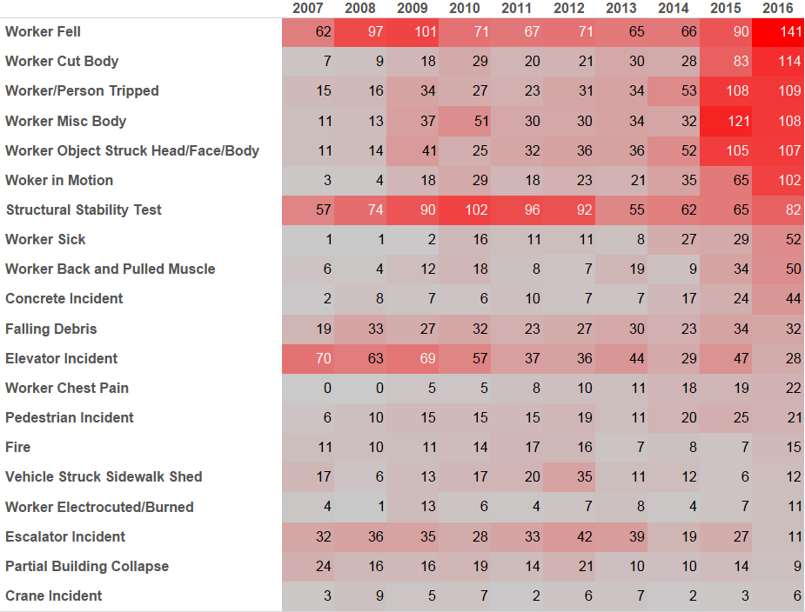
Heat Map of Topics, 2007 - 2016

Slide 15
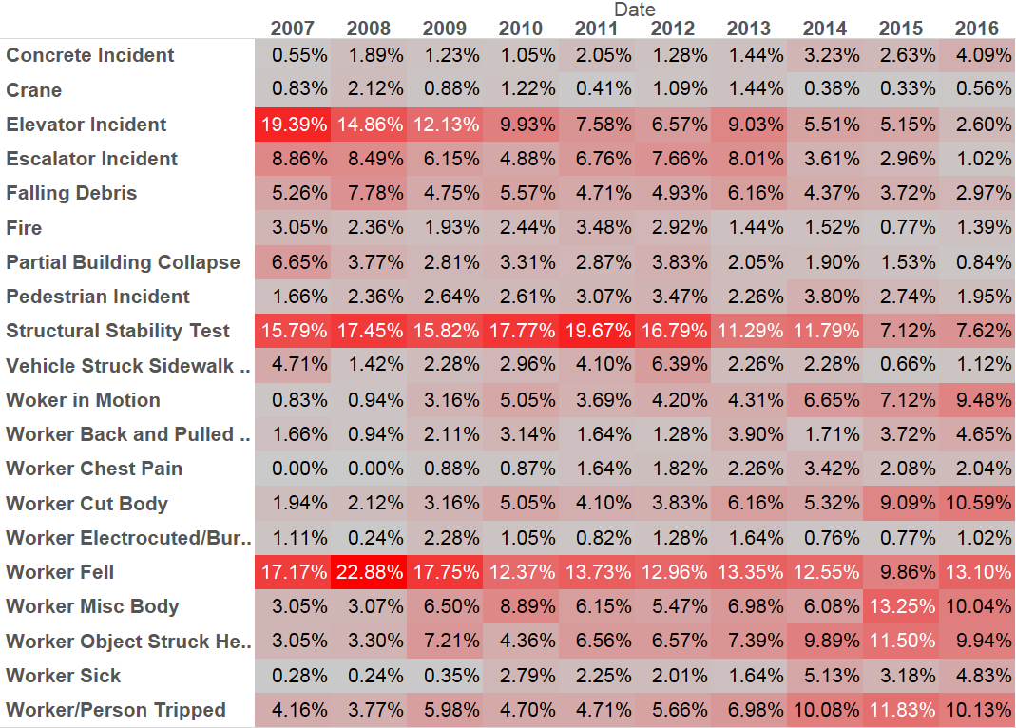
Topic Heat Map, Percent of Incidents by Year

